Slide 1
DSIC: Deep Learning based Self-Interference Cancellation for In-Band Full Duplex Wireless
Hanqing Guo, Shaoen Wu, Honggang Wang, Mahmoud Daneshmand
Present by: Hanqing Guo

Slide 2
Content
Background
In-Band Full Duplex (IBFD)
Self Interference (SI)
Deep Learning based Self Interference Cancellation
Performance Evaluation

Slide 3
Background

Slide 4
In-Band Full Duplex (IBFD)
In-band full duplex (IBFD) wireless refers to the bi-directional transmission on the same frequency band at the same time, which intuitively boosts the spectrum efﬁciency and channel utilization.
Same frequency band
Tx1
Rx1
Tx2
Rx2
Node 1
Node 2

Slide 5
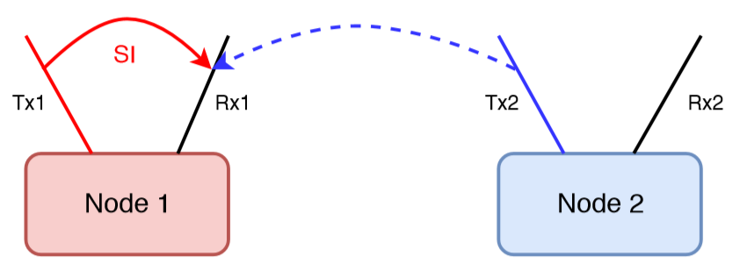
Self Interference (SI)
Self Interference (SI) is a phenomena in IBFD when a node’s transmit power overshadows its receiver chain. E.g. Rx1 is overshadowed by Tx1, thus cannot hear from TX2.
The channel between TX1 and RX1 is called SI channel.
Same Frequency band

Slide 6
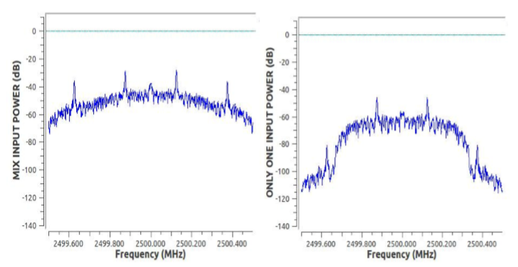
Example of Self Interference (SI)
Mix Input
Single Input
0,1 .. , 10
???
20, 21, .. , 30
Tx1
Rx1
Tx2
Rx2
Node 1
Node 2

Slide 7
Self interference cancellation

Slide 8
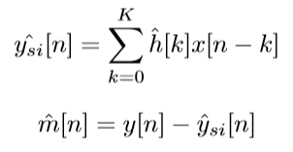
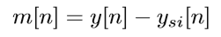
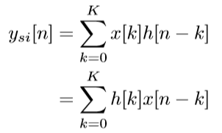
Theoretical Foundation of Digital Cancellation
Estimate SI signal
Useful signal from Tx2 to Rx1
Mix signal Received by Rx1
SI signal from Tx1 to Rx1
Recovered useful signal
Impulse respond of SI channel
Transmitted signal from Tx1
Taps

Slide 9
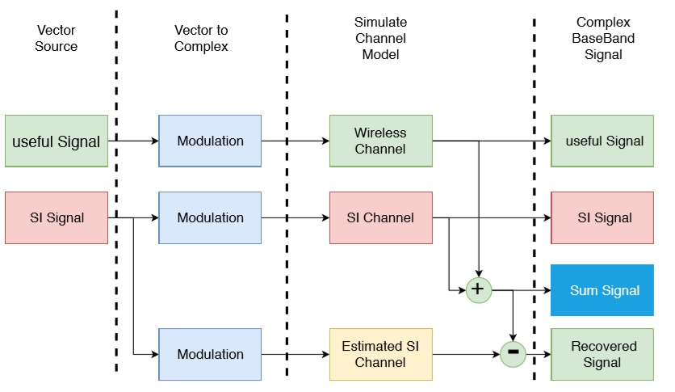
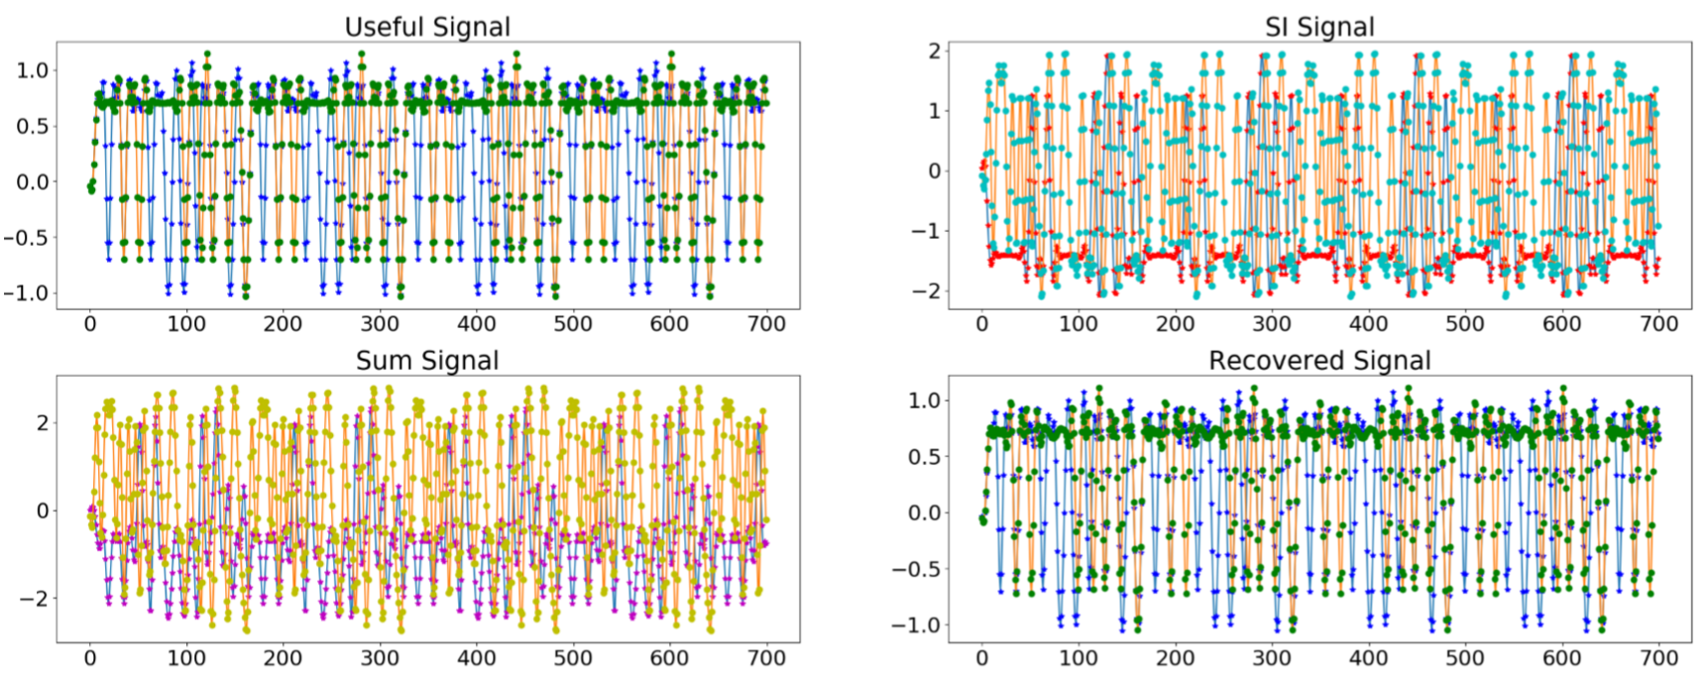
Validation of Concept

Slide 10
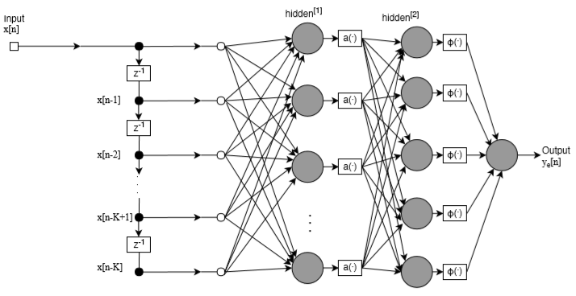
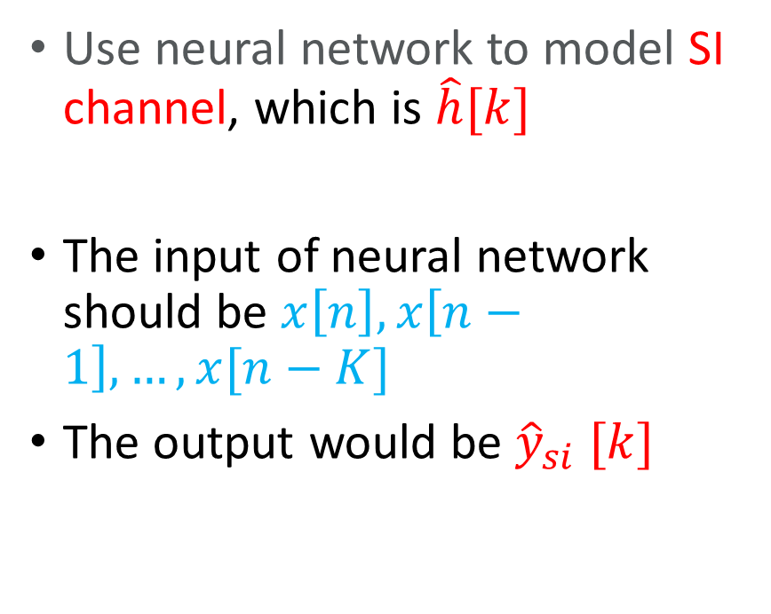
Neural Network Based SI Modeling
Use neural network to model SI channel, which is $\hat{h}[k]$
The input of neural network should be $x\left[n\right], x\left[n−1\right], …, x[n−K]$
The output would be ${\hat{y}}_{si} [k]$

Slide 11
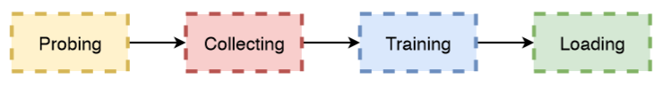
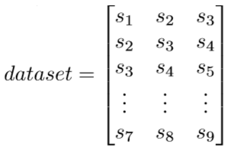
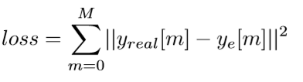
DSIC Architecture
Constructing Dataset
Training with back propagation
Loading the trained model to cancel Self-interference
K = 3

Slide 12
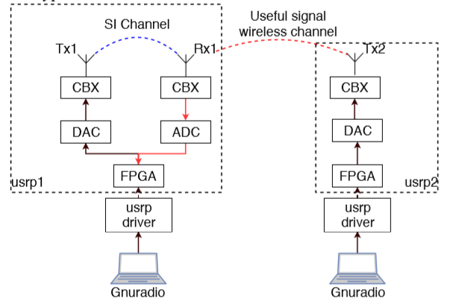
Implementation Architecture

Slide 13
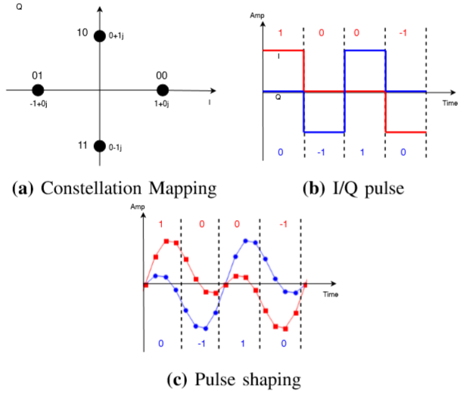
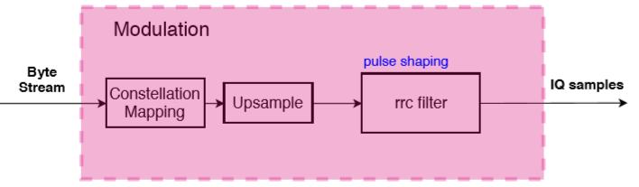
Implementation Challenge: Modulation
1+0j,
0-1j,
0+1j,
-1+0j
57
00111001
Up sampling and
Pulse shaping

Slide 14
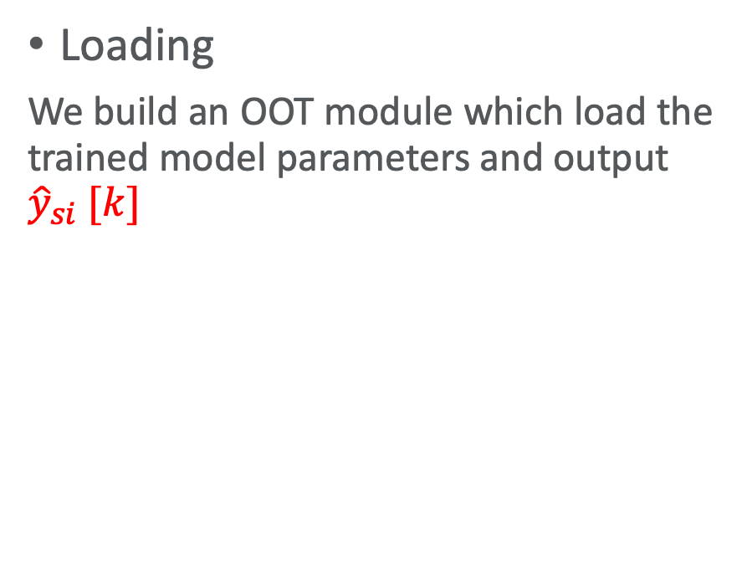
Implementation Challenge: Synchronization and Loading
Synchronization
A barker code is added at the head of every source signal sequence.
At a receiver, once if the receive chain has all barker codes in its buffer, it can extract a synchronized signal.
We have implemented a barker code based frame synchronization block in GNURadio followed by data collection block.
Loading
We build an OOT module which load the trained model parameters and output ${\hat{y}}_{si} [k]$

Slide 15
Performance Evaluation

Slide 16
Experiment Settings
File Sink1
Collecting
Barker code
57
00111001
Modulation
USRP 1 TX1
USRP 1 RX1
De-modulation
Synchronization
Notify Start Collect
File Sink2
Notify Start Collect

Slide 17
Experiment Settings
Loading
1,2, …,10
Bit streams
Modulation
USRP 1 TX1
Load Model
USRP 1 RX1
De-modulation
101,102,…,120
101,102, …,120
Bit streams
Modulation
USRP 2 TX2

Slide 18
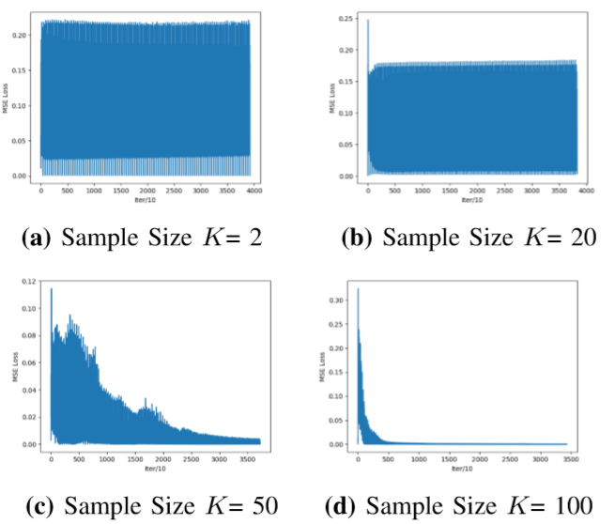
Convergence
The convergence are related to sample size K. For different length of input and modulation scheme, the best K varies.

Slide 19
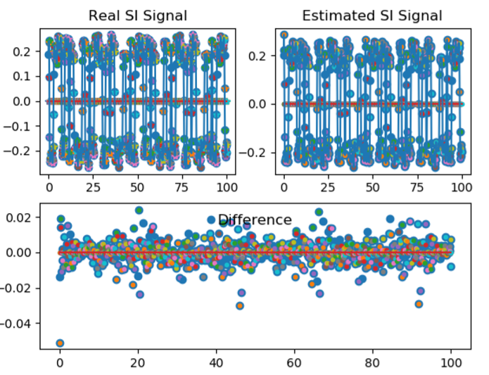
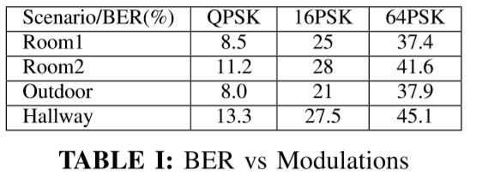
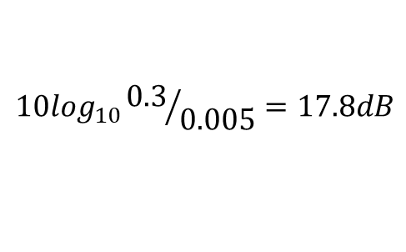
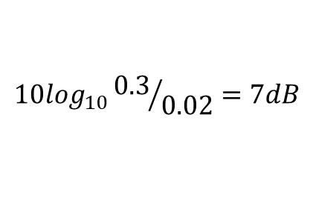
Results – Cancellation and BER
$${10log}_{10}{0.3}/{0.02}=7dB$$
$${10log}_{10}{0.3}/{0.005}=17.8dB$$

Slide 20
Q&A

